Slide 1
4COSCO11C.2 Web Design and Development
JavaScript and DOM,
JavaScript Event Listeners and Callbacks
Week 9

Slide 2
Introduction to the HTML DOM (Document Object Model)
We will only cover aspects of the DOM that we need to read/change form element values/settings, document content and document style attributes, so we will not cover the DOM in full
The Document Object Model is a platform- and language-neutral interface that will allow programs and scripts to dynamically access and update the content, structure and style of documents.
The document can be further processed and the results of that processing can be incorporated back into the presented page. This is an overview of DOM-related materials here at W3C and around the web. (W3C)
The HTML DOM model is constructed as a tree of Objects, created by the browser, so we can quickly find HTML elements using JavaScript

Slide 3
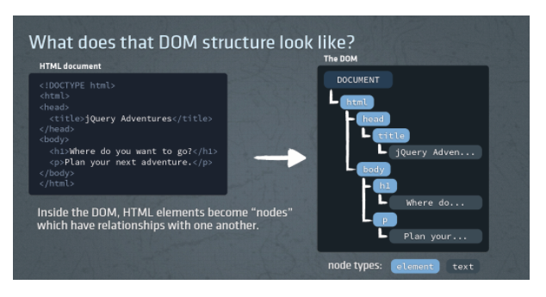
DOM

Slide 4
JavaScript and the DOM
JavaScript can be used to:
change HTML elements in the page
change HTML attributes in the page
change the CSS styles in the page
react to the events in the page
Finding HTML Elements
JavaScript is often used to manipulate HTML elements.
To do so, you have to find the elements first. You can do this by:
finding HTML elements by id
finding HTML elements by tag name
finding HTML elements by class name

Slide 5
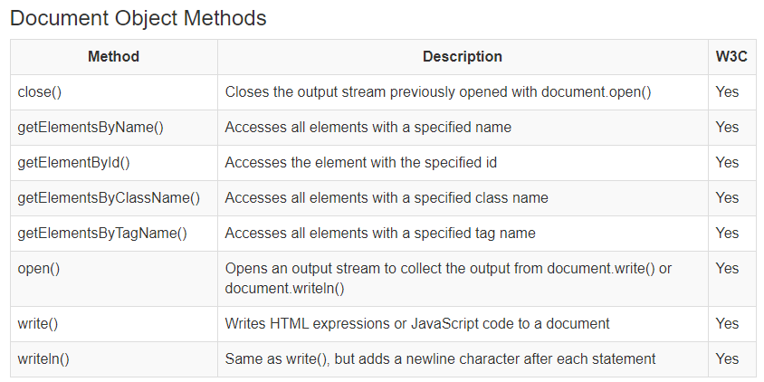
DOM - Methods

Slide 6
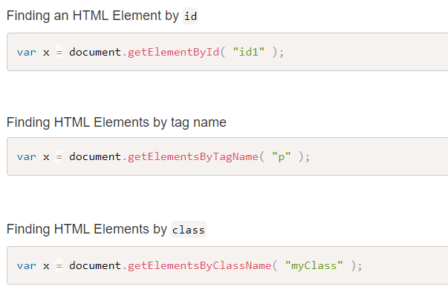
DOM - Methods

Slide 7
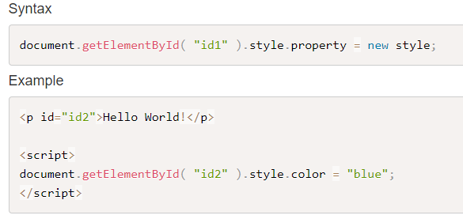
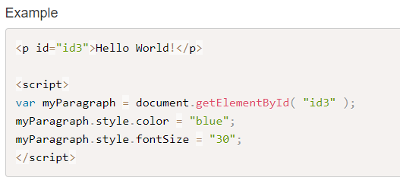
Setting Style Properties to HTML Elements

Slide 8
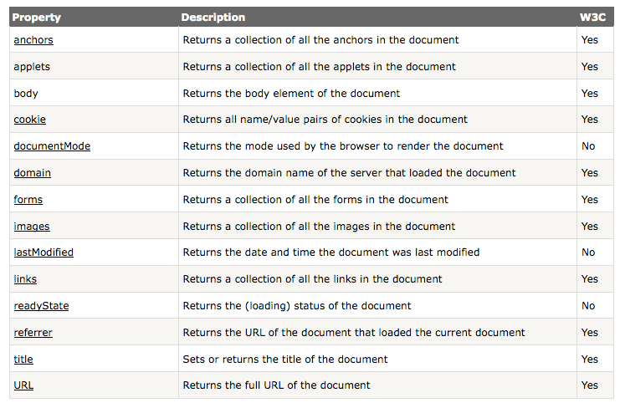
Document Object Properties

Slide 9
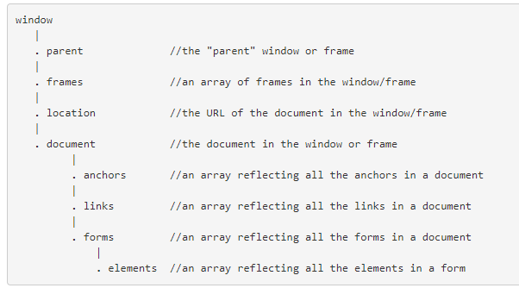
Object Properties Can Be Other Objects
Objects can be partly made up of, or contain, other objects.
Here is part of the browser's heirarchy of ready made JavaScript objects:

Slide 10

Dot Notation
Statements such as this are common in JavaScript programming.
awindow refers by name to a window, document is the document in that window, aform is the name of a form in the document, elements[ 2 ] refers to the third element in the form and value will return the value of that element.

Slide 11
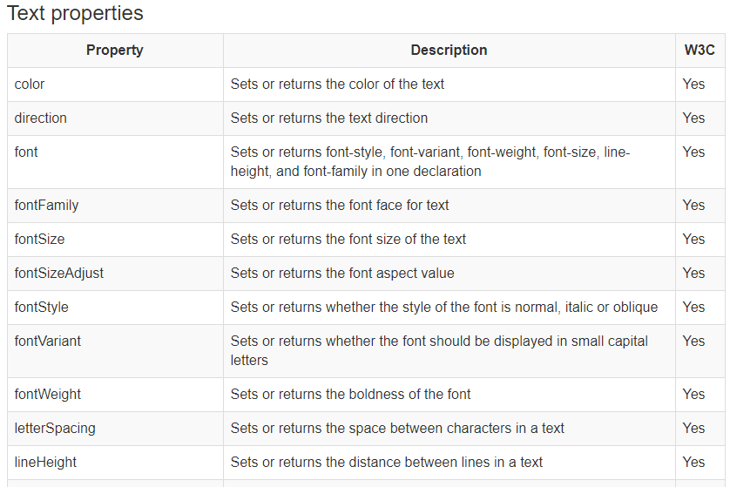
Changing HTML Style with the HTML DOM Style Object

Slide 12
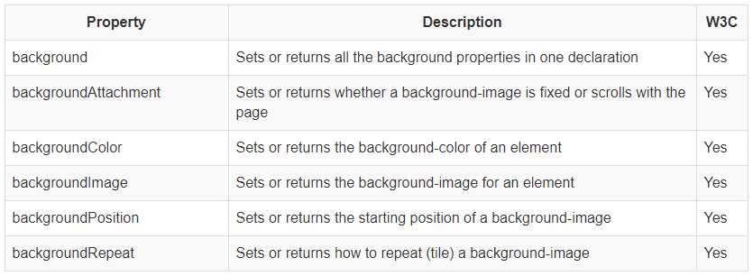
Background properties

Slide 13
HTML DOM Events
HTML DOM events allow JavaScript to register different event handlers on elements in an HTML document.
Events are normally used in combination with functions, and the function will not be executed before the event occurs (such as when a user clicks a button).
Some common uses of events
When a user clicks the mouse
When a web page has loaded
When an image has been loaded
When the mouse moves over an element
When an input field is changed
When an HTML form is submitted
When a user strokes a key

Slide 14
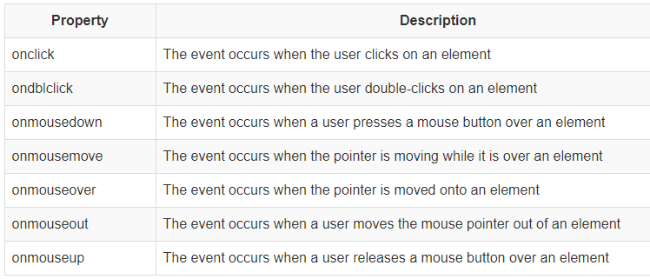
Mouse Events

Slide 15
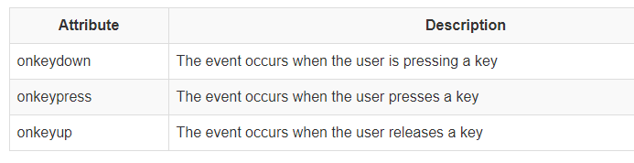
Key Board Events

Slide 16
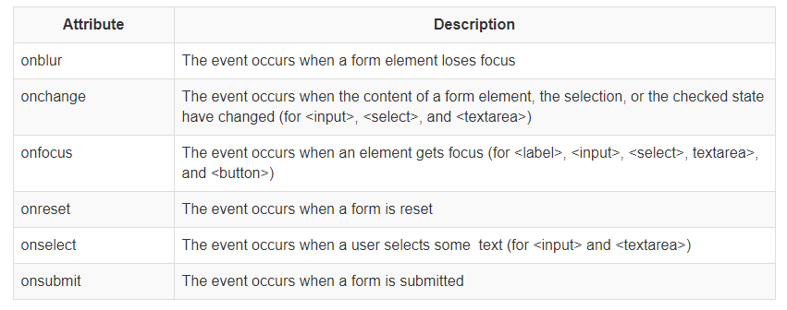
Form Events

Slide 17
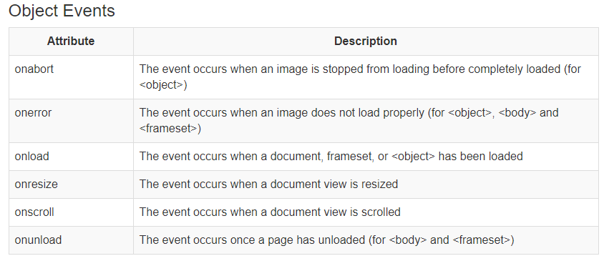
Object Events

Slide 18

Reacting to Events
A JavaScript can be executed when an event occurs, like when a user clicks on an HTML element.
To execute code when a user clicks on an element, add JavaScript code to an HTML event attribute:

Slide 19
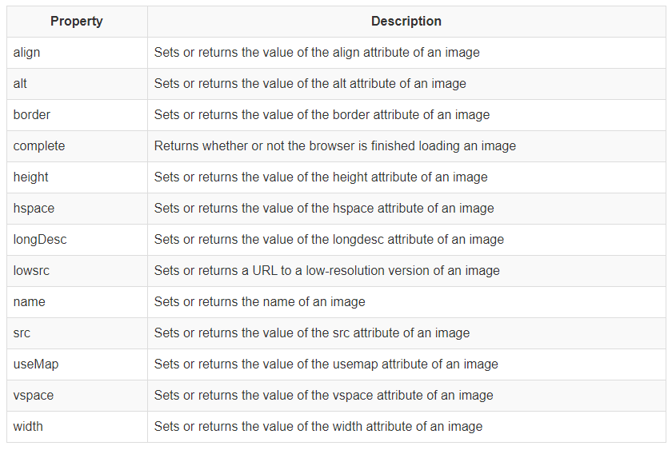
Image Replacement
Image Properties

Slide 20
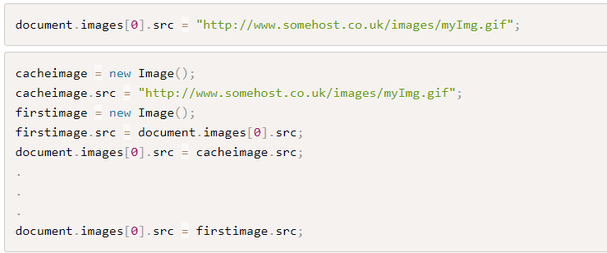
Image Replacement
Replacing an image already loaded onto a page is done by changing the image object's src attribute to either the URL of another image file or to the src of another image object.
Here are two code examples:

Slide 21
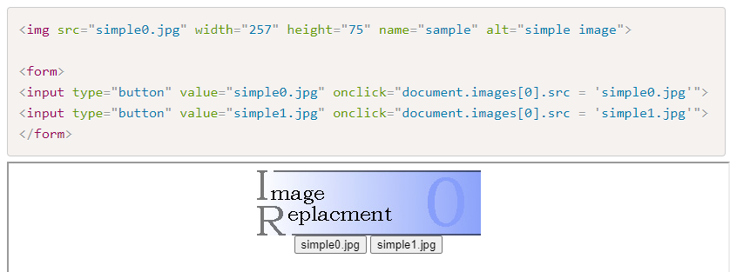
A Simple Example
Changing the URL of the image using the src property causes the new image to be loaded gradually onto the page.
Replacement is not immediate.

Slide 22
Preloading Images into Cache
Using the image object it is possible to begin loading both images as the page loads.
Page loading is slowed down as both images are loaded and so the first image may take longer to appear.
Once they are both loaded image replacement is very fast.

Slide 23
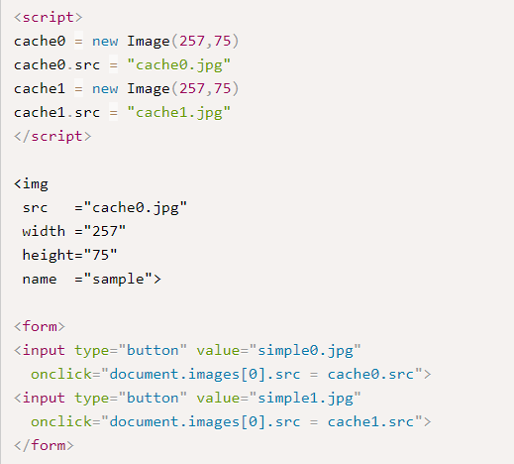
Preloading Images into Cache

Slide 24

the setTimeout() method
The window.setTimeout() method can be written without the window prefix.
The setTimeout() method will wait the specified number of milliseconds, and then execute the specified function.
The first parameter of setTimeout() should be a function.
The second parameter indicates how many milliseconds, from now, you want to execute the first parameter.

Slide 25
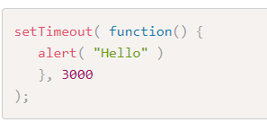
Example
Wait 3 seconds, then alert "Hello“:

Slide 26
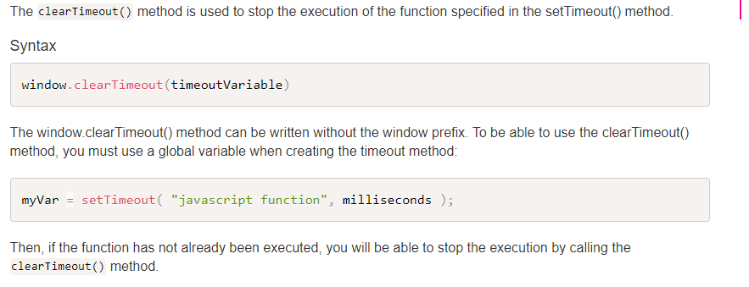
How to Stop the Execution?

Slide 27
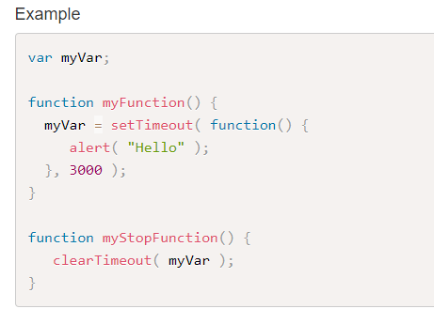
Example

Slide 28
The addEventListener() method
We have used DOM events previously by adding listeners directly in the html element.
However, in order to totally separate the HTML from the JavaScript code, it is better practice to add the event Listener inside the JavaScript code by using the addEventListener() method.
This improves separation of concerns, readability and allows you to add the event listeners and effects even if you do not have control over the HTML code.
The addEventListener() method attaches an event handler to a specified element.
It will not overwrite existing event handlers on that element, so it is possible to add many event handlers to one element, including more than one identical event handler (e.g. you can add two click event listeners to the same element).
The other advantage of using the addEventListener() method, is that you get control of the event bubbling (how the event propagates through the DOM nodes).
You can remove an event listener by using the removeEventListener() method.

Slide 29
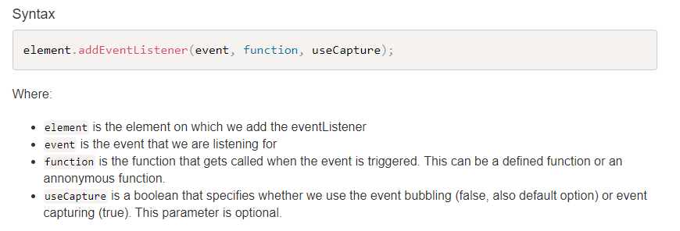
The addEventListener() method

Slide 30
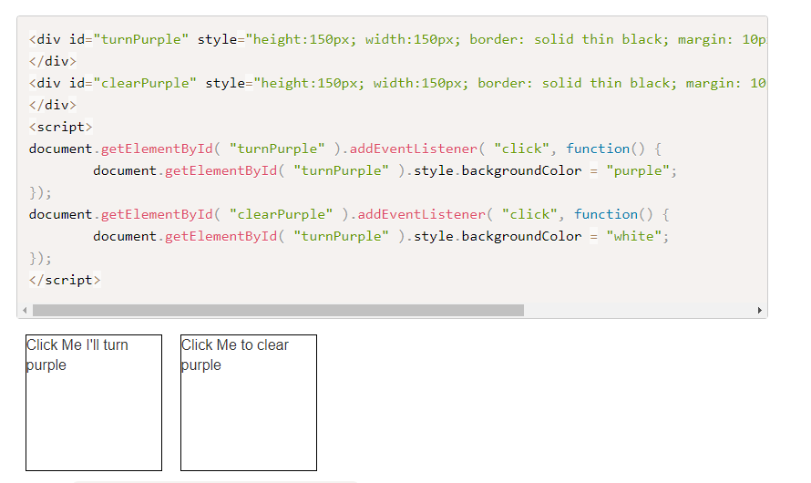
Example – Change Background color

Slide 31
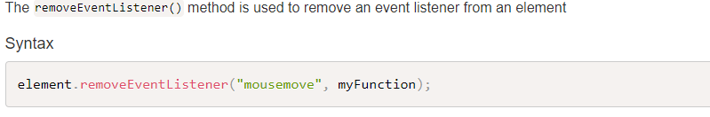
The removeEventListener() method

